Slide 1
Weather Instruments

Slide 2
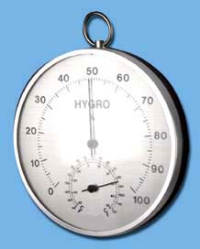
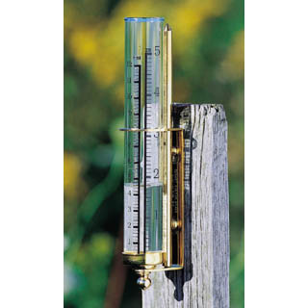
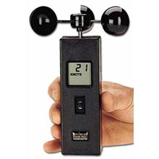
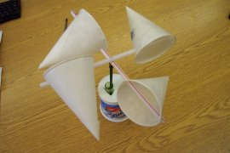
Weather Instruments
Used to measure the 5 major parts of weather observation
1. Atmospheric pressure
2. Humidity
3. Precipitation
4. Wind
5. Temperature

Slide 3
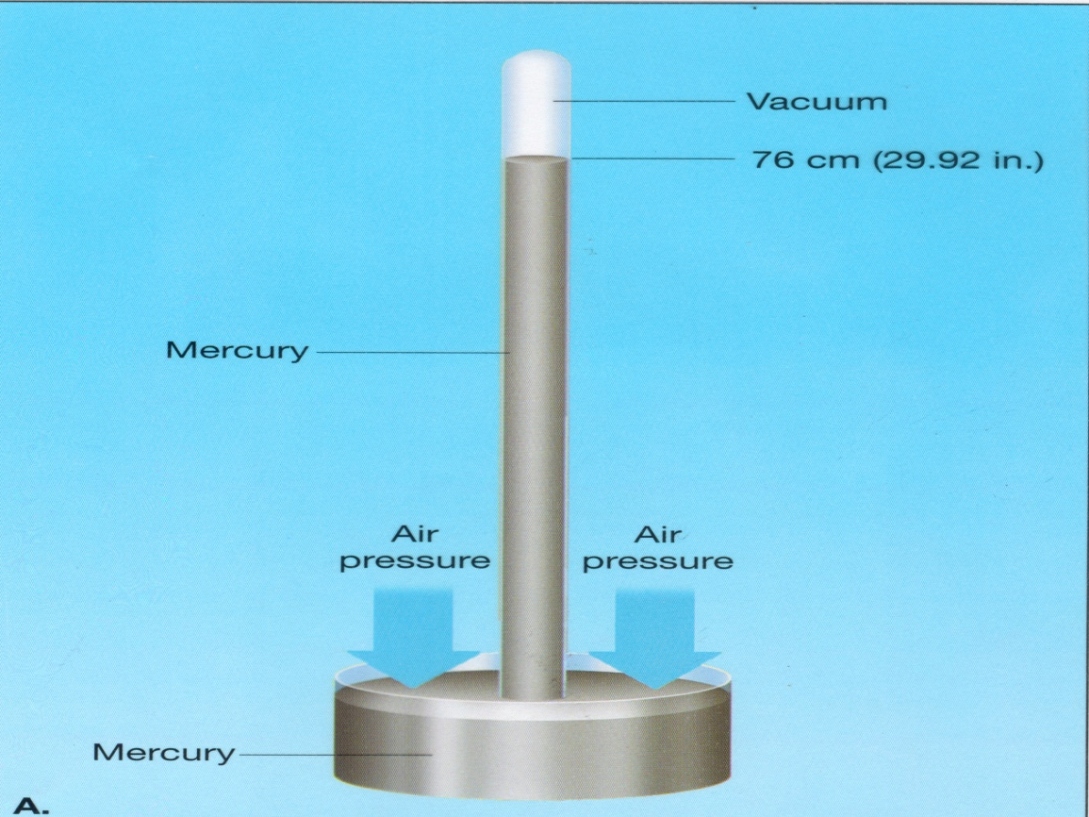
Tools: Atmospheric Pressure
Barometer:
Measures air pressure, millibars or inches of mercury

Slide 4
Tools: Humidity
(Sling) Psychrometer:
Difference between wet bulb and dry bulb used to determine relative humidity.

Slide 5
Tools: Precipitation
Rain Gauge:
Simple funnel with marks
associated with units: cm or in.

Slide 6
Tools: Temperature º C or º F
Thermometer:
Usually uses alcohol.
Some used mercury.
Liquid contracts and expands in the glass tube.

Slide 7
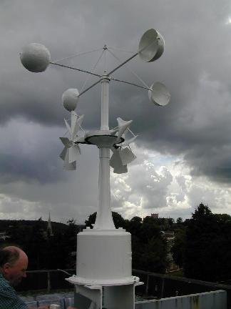
Tools: Wind
Anemometer – Wind Speed
km per hour
mi per hour
Wind Vane – Wind Direction

