Slide 1
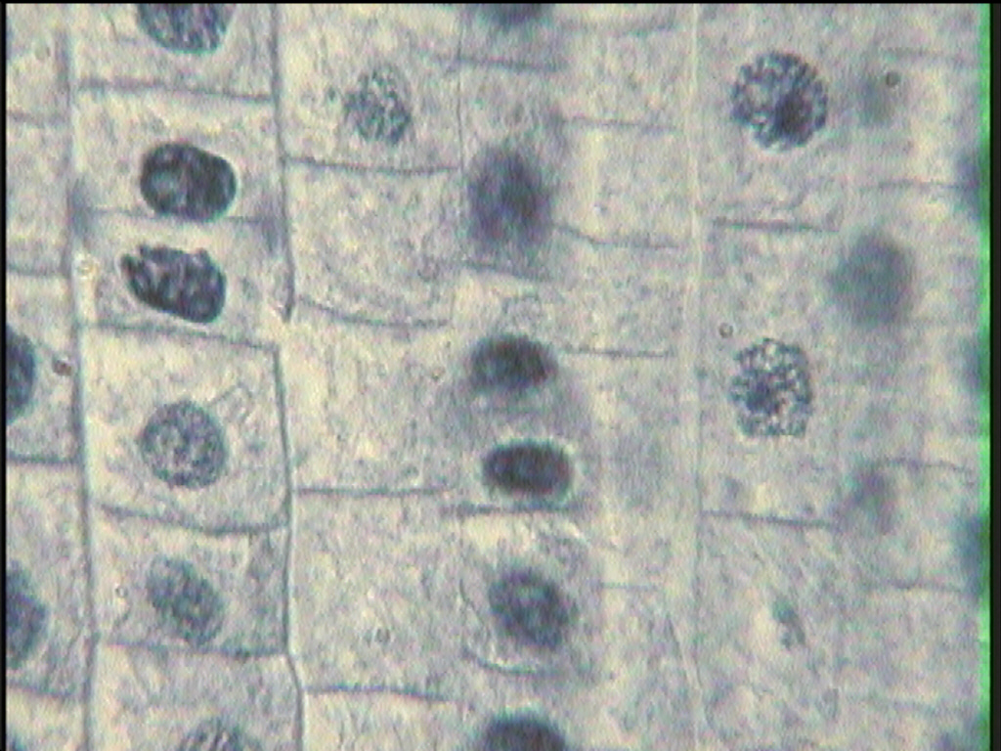
Asexual Reproduction
Mitosis
Mitosis is the process in which the nucleus divides to form two new nuclei.
7th Grade Life Science
1

Slide 2
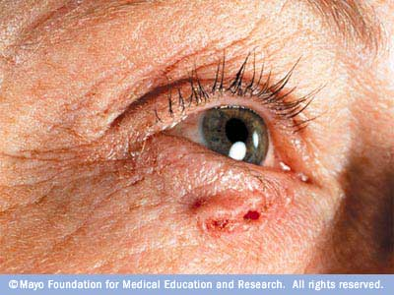
Three reasons why cells reproduce by asexual reproduction: 1. Growth 2. Repair 3. Replacement
Skin cancer - the abnormal growth of skin cells - most often develops on skin exposed to the sun.
Cell that reproduce by asexual reproduction reproduce constantly.

Slide 3
Mitosis Cycle
Interphase
Prophase
Metaphase
Anaphase
Telophase
Cytokinesis

Slide 4
Interphase occurs before mitosis begins
Chromosomes are copied (# doubles)
Chromosomes appear as threadlike coils (chromatin) at the start, but each chromosome and its copy(sister chromosome) change to sister chromatids at end of this phase
CELL MEMBRANE
Nucleus
Cytoplasm

Slide 5
Interphase
Animal Cell
Plant Cell
Photographs from: http://www.bioweb.uncc.edu/biol1110/Stages.htm

Slide 6
Prophase 1st step in Mitosis
Mitosis begins (cell begins to divide)
Centrioles (or poles) appear and begin to move to opposite end of the cell.
Spindle fibers form between the poles.
Centrioles
Sister chromatids
Spindle fibers

Slide 7
Prophase
Animal Cell
Plant Cell
Spindle fibers
Centrioles
Photographs from: http://www.bioweb.uncc.edu/biol1110/Stages.htm

Slide 8
Metaphase 2nd step in Mitosis
Chromatids (or pairs of chromosomes) attach to the spindle fibers.
Centrioles
Spindle fibers

Slide 9
Metaphase
Animal Cell
Plant Cell
Photographs from: http://www.bioweb.uncc.edu/biol1110/Stages.htm

Slide 10
Anaphase 3rd step in Mitosis
Chromatids (or pairs of chromosomes) separate and begin to move to opposite ends of the cell.
Centrioles
Spindle fibers

Slide 11
Anaphase
Animal Cell
Plant Cell
Photographs from: http://www.bioweb.uncc.edu/biol1110/Stages.htm

Slide 12
Telophase 4th step in Mitosis
Two new nuclei form.
Chromosomes appear as chromatin (threads rather than rods).
Mitosis ends.
Nuclei
Nuclei
Chromatin

Slide 13
Telophase
Animal Cell
Plant Cell
Photographs from: http://www.bioweb.uncc.edu/biol1110/Stages.htm

Slide 14
Cytokinesis occurs after mitosis
Cell membrane moves inward to create two daughter cells – each with its own nucleus with identical chromosomes.

Slide 15
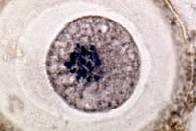
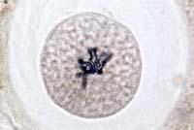
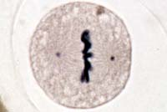
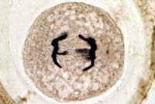
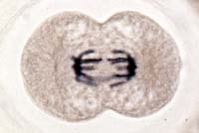
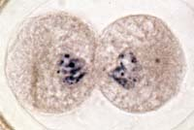
Animal Mitosis -- Review
Interphase | Prophase
Metaphase | Anaphase
Telophase | Cytokinesis

Slide 16
REMEMBER!
Interphase
Prophase
Metaphase
Anaphase
Telophase
Cytokinesis
IPMATC
I Pray More At The Church
Notes:
A mnemonic to help remember the stages of mitosis.

Slide 17
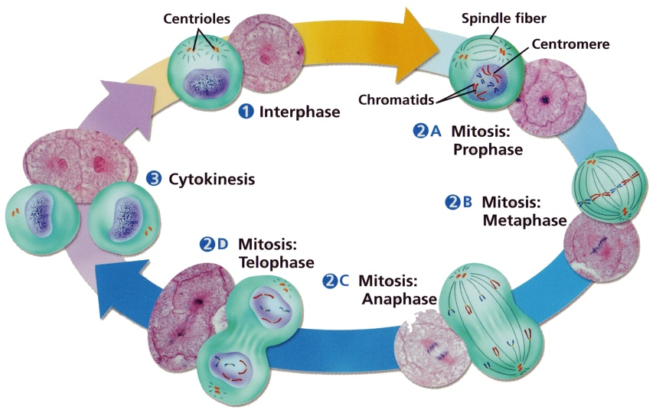
Cell Cycle

Slide 18
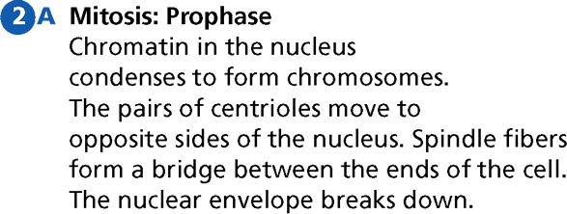
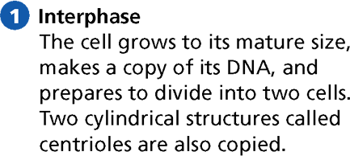
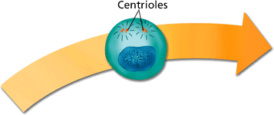
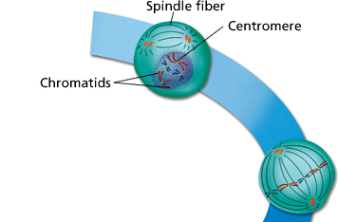
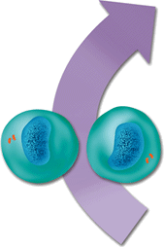
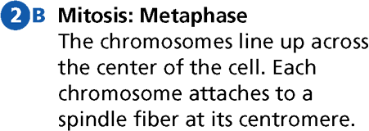
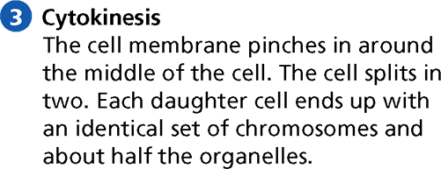
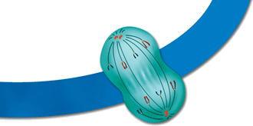
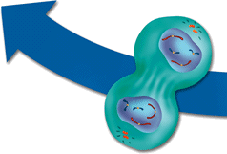
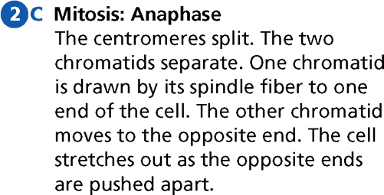
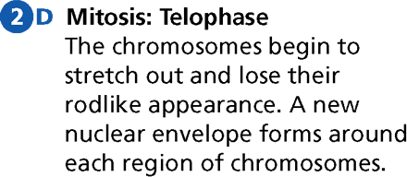
The Cell Cycle
- Cell Division
18

