Slide 1
How do human activities affect the environment?

Slide 2
Human impacts on the Environment
Global warming
Use of machinery by humans seems to be increasing CO₂ levels in the air. CO2 prevents heat from escaping
Rising water temperatures causes coral bleaching

Slide 3
Human impacts on the environment
Deforestation
Caused by demand for wood products,
need for space, farmland, housing,
roads
Deforestation causes habitat
fragmentation. Animals and plants are
forced into confined areas

Slide 4
Human impacts on the Environment
Ozone depletion
Caused by aerosol chemicals called
chlorofluorocarbons (CFCs)
CFC’s
Escape into atmosphere, reacts breaking down the ozone
UV rays penetrate the atmosphere and cause harm to many organisms

Slide 5
“HOLE” in the ozone (O3)

Slide 6
Human impacts on the Environment
Fishing activities
Demand for fish and shellfish
Commercial Fishing can be harmful to the environment

Slide 7
Human impacts on the environment
Invasive species (EXOTIC SPECIES)
Introduced by people accidentally or intentionally
Can cause problems if no natural enemies are
present

Slide 8
Human impacts on the Environment
Exotic pet trade
Capture and sell wild animals from
exotic locations
Animals removed from their habitat
causes an imbalance in the ecosystem

Slide 9
Importance of the Environment
Biodiversity = Many different types of organisms
Organisms depend upon one another
Interfering with one
Organism can have a
Ripple effect to many
w/in the habitat

Slide 10
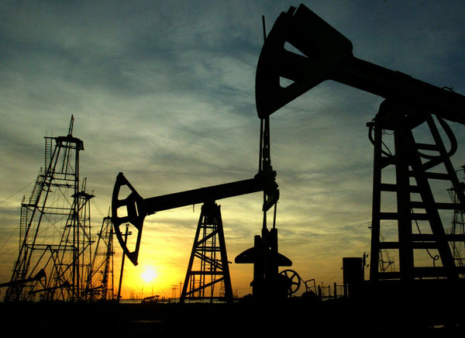
Importance of the environment
Natural resources:
Non-renewable includes fossil fuels (petroleum, coal) can run out

Slide 11
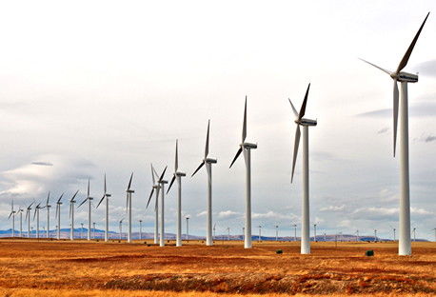
Importance of the Environment
Natural resources
Renewable energy sources include wind power, geothermal energy, ocean currents

Slide 12
Pollution:
Agricultural
DDT
Fertilizers
Animal wastes (nitrogen)
Homes
Strong cleaning agents
Industry
Toxic gases and wastes
Acid rain

