Slide 1
HEAT TEMPERATURE AND WEATHER

Slide 2
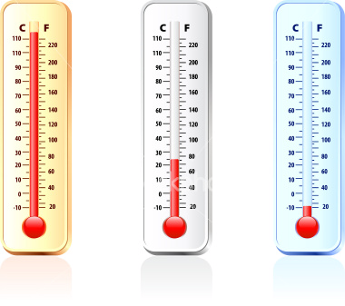
First…HEAT vs. TEMPERATURE
Temperature is the measure of the amount of energy that something has.
When someone asks, “What is the temperature outside?”
“How much ENERGY does the air have?”

Slide 3
When a thermometer shows a high temperature, the air molecules have a lot of energy so they are hitting the bulb more rapidly and harder.
The long lines represent lots of energy!

Slide 4
When a thermometer shows a low temperature, the air molecules have very little energy so they are hitting the bulb very slowly and not as hard.
The short lines represent low energy!

Slide 5
Back to our original thought…
HEAT vs. TEMPERATURE
Remember that temperature is a measure of the amount of energy that something has.
Heat is the transfer of this ENERGY!
When a high energy molecule hits a low energy molecule…one loses energy while the other gains energy.

Slide 6
Think back…why do metal objects feel cold?
Your finger has more energy than the wrench (metal object). The wrench takes energy from your finger causing it to “feel” cold.

Slide 7
How does all of this relate to WEATHER?
Weather is caused by our atmosphere gaining
and losing energy.
All of the energy in our atmosphere
originally came from the SUN!

Slide 8
The energy from the sun can be transferred around the earth in three different ways!
Radiation
Conduction
Convection

Slide 9
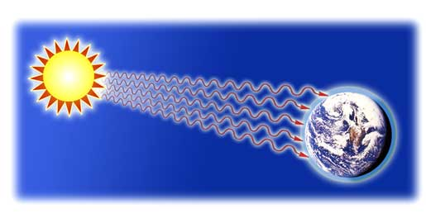
Radiation
Radiation is the transfer of energy by
electromagnetic waves
Therefore, both the Sun and Earth heat the atmosphere.
Both the Sun and the Earth emit (give off) radiation.

Slide 10
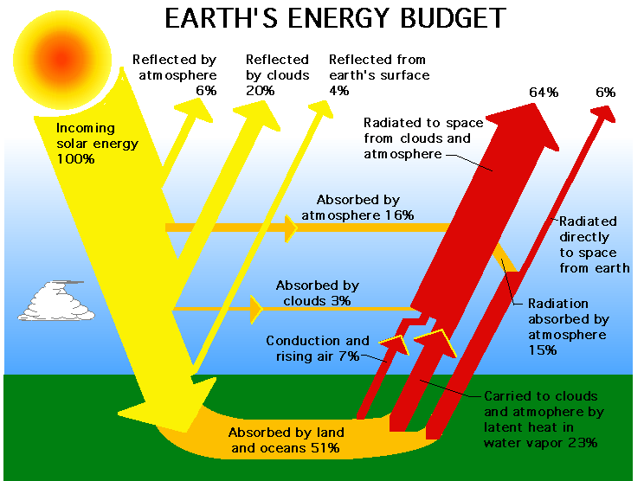
Most of the Sun’s radiation is absorbed by the Earth’s atmosphere, clouds, or surface.
(Heat transfer - energy added)

Slide 11
After the surface is heated up, that energy is radiated back into the atmosphere. The atmosphere absorbs this energy.

Slide 12
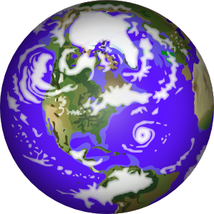
Darker surfaces on Earth absorb more heat…therefore they radiate more energy into the atmosphere.

Slide 13
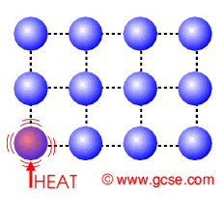
Conduction
Conduction is the transfer of energy by
direct contact of molecules or objects.

Slide 14
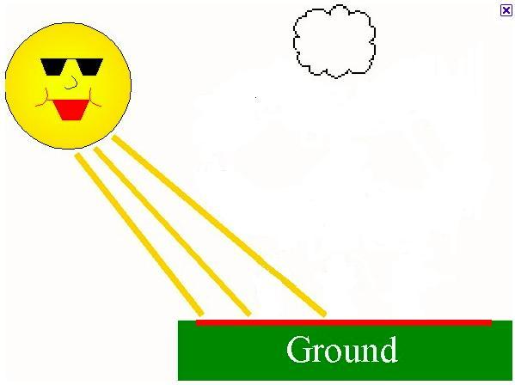
The air above the ground is heated directly by
contact with the Earth.
Conduction

Slide 15
Darker surfaces on Earth absorb more heat…therefore they Conduct more energy into the atmosphere.

Slide 16
Convection
Convection is the transfer of energy by
the movement of a liquid or gas.
Warm/Hot air has a lot of more
energy than cold air

Slide 17
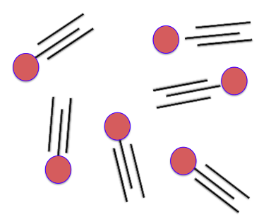
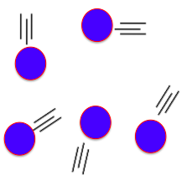
Since Warm/Hot air has more energy, it expands and takes up more space than cold air.
Warm Air – More energy -> Expands
Cold Air – Less energy -> Shrinks

Slide 18
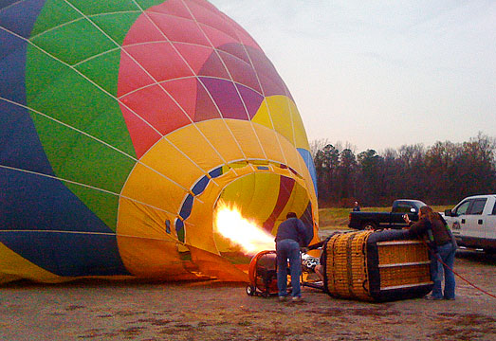
A hot air balloon is a great example that demonstrates warm air expanding and rising.

Slide 19
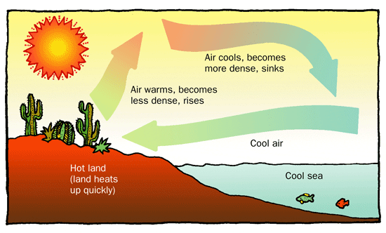
Convection in our atmosphere
Land heats up faster than water. The air above the land in return gets warmed up. This warm air rises. Cooler air from over the water comes in to take its place.

Slide 20
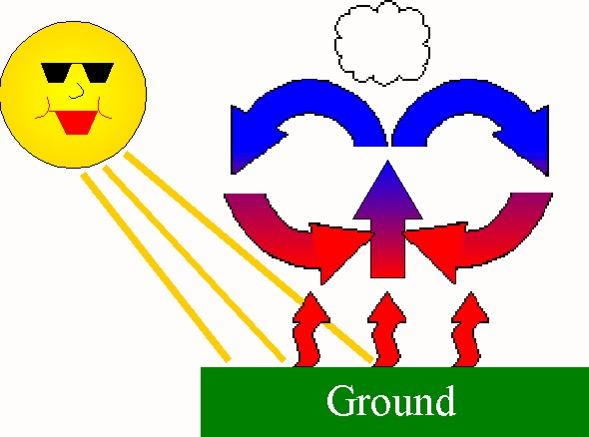
Warm air expands and rises.
As it rises, it cools or loses energy.
The cool air then sinks back down to be reheated by the Earth.

Slide 21
Due to warm air rising and cool air coming in to take its place… WIND is created!
W
A
R
M
AIR
COLD AIR

Slide 22
To review…the energy from the sun can be transferred around the earth in three different ways!
Radiation
Conduction
Convection
These three types of HEAT TRANSFER cause weather on Earth to occur.

Slide 23
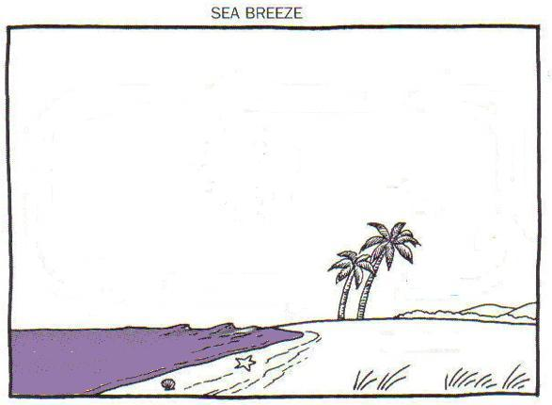
5) Cool air sinks
4) Warm air rises
4&5) Show
convection
taking place
1) Radiant heat from sun warms land & water
2) Land &
water radiate
heat into the
atmosphere
(infrared waves)
3) Land &
water also heat the air by direct contact (Conduction)

Slide 24
The SUN supplies all the energy in our atmosphere!
This energy is what causes our WEATHER!

