Slide 1
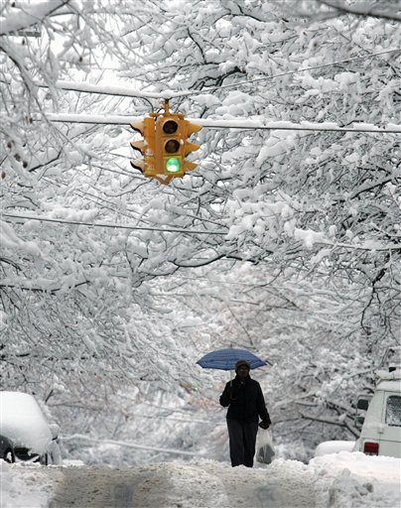
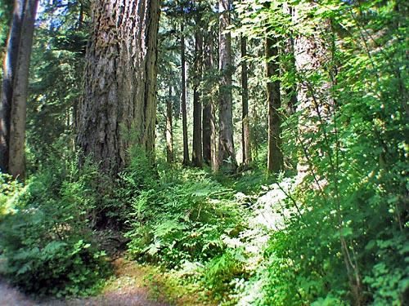
Climate

Slide 2
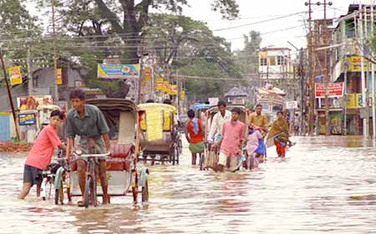
Climate is…
An area’s long-term pattern of weather.
It includes characteristics such as how hot summers are, how cold winters are, and how much precipitation falls at different times of year.
2 main characteristics:
Temperature &
Precipitation

Slide 3
Climate Controls
Climate depends on a set of conditions called climate controls. These include:
Latitude: how much solar radiation a location receives.
Proximity to water
Altitude/Elevation
Proximity to mountains
Ocean currents
Prevailing Winds

Slide 4
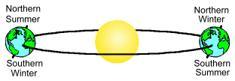
1. Latitude
A location’s position relative to the equator determines how much solar radiation it receives, and therefore affects its temperature.
*Remember as Earth revolves around the Sun, the tilt influences how much solar radiation a location receives & seasons change.

Slide 5
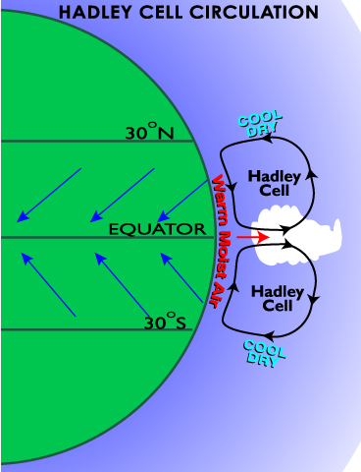
1. Latitude
Also, the latitude relative to convection cells in our troposphere affects precipitation.
Dry at 30 N & S
Moist at equator

Slide 6
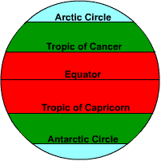
Zones of Latitude
A region’s latitude (distance from the equator) can impact its climate.
Sketch the diagram below.
Polar
Temperate
Tropical
Tropical
Temperate
Polar

Slide 7
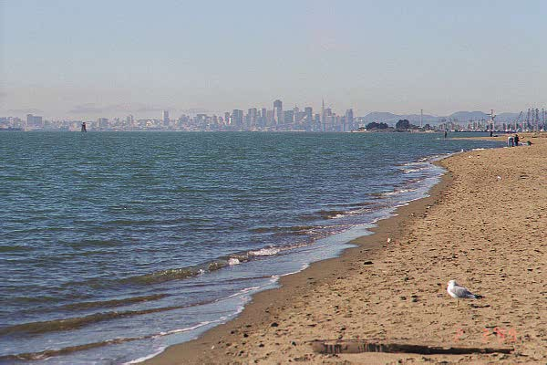
2. Proximity to Water
Because water heats and cools slowly, it has a low temperature range. Therefore land masses beside large bodies of water usually have mild climates.
Large bodies of water add water vapor to the air, so precipitation is more likely downwind of water
Ever heard of “lake effect” snow?

Slide 8
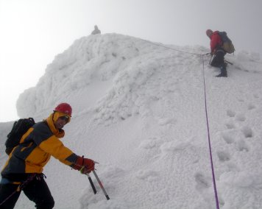
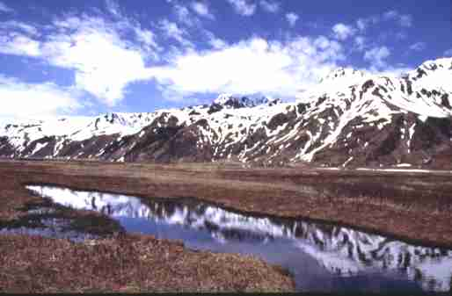
3. Altitude/Elevation
As you go up in the Troposphere (bottom layer of the atmosphere) temperature decreases.
Therefore, the higher the elevation of the land, the colder it is, generally.

Slide 9
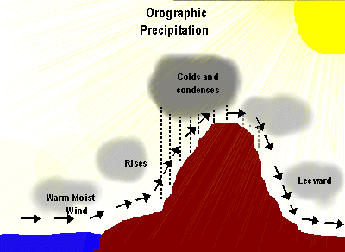
4. Proximity to Mountains
Mountains can affect precipitation by making a Rain Shadow.
On the windward side of the mountain, air is forced to rise. As it rises, it cools. As it cools, it loses its ability to hold water, and precipitation occurs on the windward side. As the air travels to the leeward side, it no longer contains moisture, the air is dry. This is why there are deserts on the east side of our Rocky Mountains

Slide 10
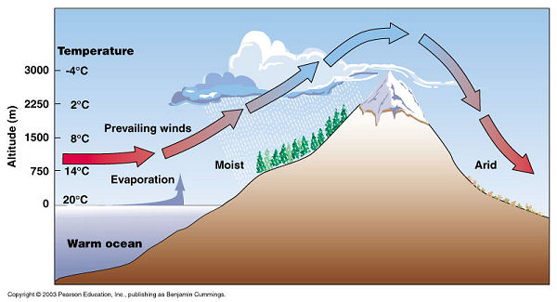
Result of Rain Shadow

Slide 11
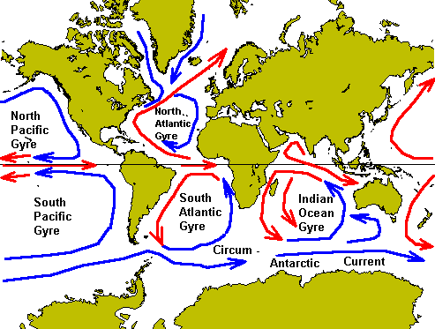
5. Ocean Currents
Global circulation of heat in the oceans moves heat energy around the world.

Slide 12
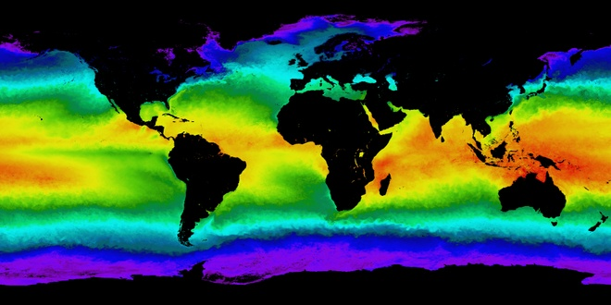
Warm Ocean Currents
Where is the water the warmest ?

Slide 13
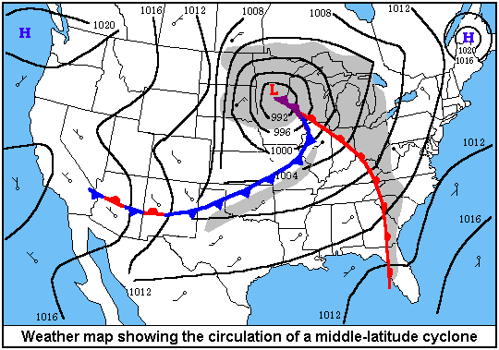
6. Prevailing Winds
Global Wind Patterns cause there to be a predominant wind direction in some areas. This influences the type of weather that approaches you.
Prevailing Westerlies cause weather patterns to move from west to east across the United States.

