Slide 1
Cell Specialization: The Diversity of Cellular Life

Slide 2
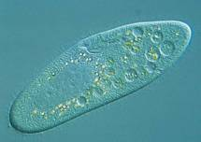
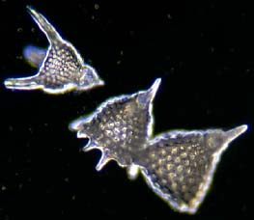
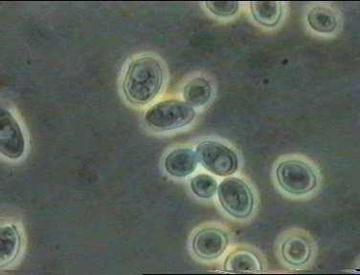
Unicellular Organisms
All living things are made up of cells…
Sometimes, a single cell IS the organism!!
Unicellular organisms:
Grow
Respond to their environment
Transform energy
Reproduce
According to numbers, they dominate Earth!

Slide 3
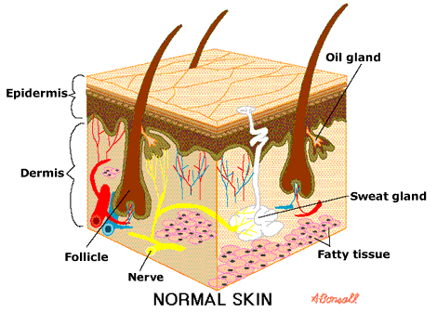
Multicellular Organisms
Made up of many cells
All multicellular organisms depend on communication and cooperation among specialized cells.
Cells throughout an
organism can develop
in different ways to
perform different tasks.
(=cell specialization)

Slide 4
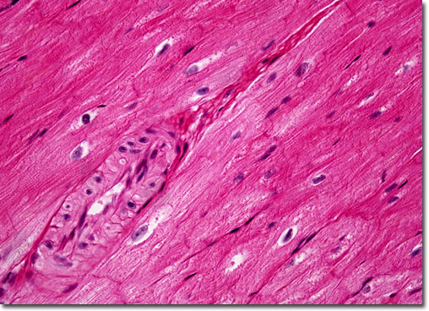
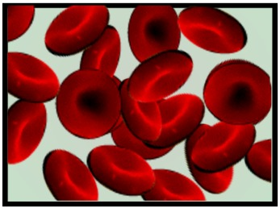
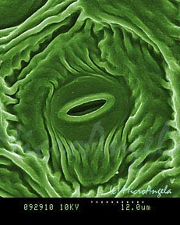
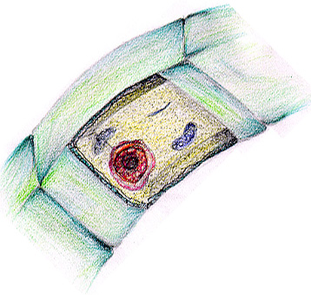

Slide 5
Specialized Animal Cells
Animal cells are specialized in many ways:
RBCs are specialized to transport oxygen
Cells that produce proteins are found in the pancreas (need lots of enzymes there!)
Humans can move because muscle cells are specialized…these cells have overly developed cytoskeletons!

Slide 6
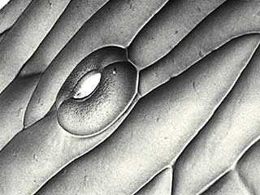
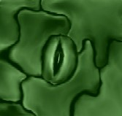
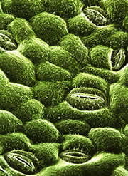
Specialized Plant Cells
Plants also have many specialized cells.
Tiny openings called stomata on the underside of leaves are part of guard cells that regulate gas exchange

Slide 7
Levels of Organization
CELLS → TISSUES → ORGANS →
ORGAN SYSTEMS

Slide 8
Tissues
Similar cells are grouped into tissues.
These cells perform similar functions
Most animals have four main types
Muscle
Epithelial
Nervous
connective

Slide 9
Organs
Some of the things we (and other organisms) do are too complicated for one type of tissue…so several types of tissues get together to work together as an organ.
Ex: Each muscle in your body is an organ
Each muscle includes muscle tissue, nervous tissue, and connective tissue.
Each type of tissue helps the organ function!

Slide 10
Organ Systems
An organ completes a series of tasks
Groups of organs that work together to perform a specific function are called organ systems.
Ex: Digestive system, endocrine system…
This division of labor makes multicellular life possible…nerve cells couldn’t function without pancreatic cells!

Slide 11
Examples
Cell – blood, nerve, skin
Tissue – connective, nervous, muscle
Organ – liver, kidney, heart, lung
Organ system – skelatal, muscular, respiratory, digestive

