Slide 1
AIR MASSES AND FRONTS

Slide 2
Air Masses
=
Warm air forms over tropical regions near the equator.
T- Tropical
Cold air forms over polar regions.
P- Polar
Wet air masses form over water
m- maritime
Dry air masses from over land.
c- continental

Slide 3
Air masses
Moisture content is noted by the first letter.
m – maritime – wet
c – continental – dry
Temperature is noted by the second letter.
P – polar – cool
T – tropical - warm

Slide 4
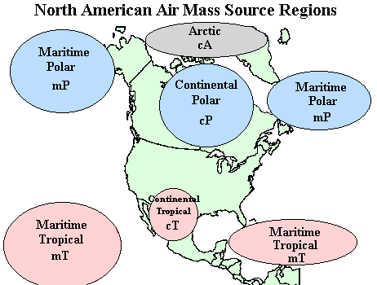

Slide 5
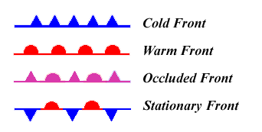
Fronts
A front is a boundary between air masses.
Four types of fronts and map symbols
Cold front
Warm front
Occluded front
Stationary front

Slide 6
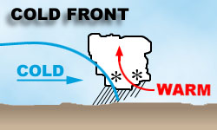
Cold Front
When a fast moving cold air mass runs into a slow moving warm air mass and the thicker cold air slides under the lighter warmer air.

Slide 7
A cold front symbol—The direction that the teeth point indicate the direction the front is moving.

Slide 8
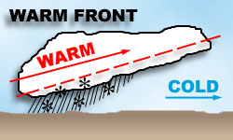
Warm Front
When a moving warm air mass collides with a slowly moving cold air mass and the warm air moves over the cold air.

Slide 9
Warm Front symbol—The directions that the bumps face is the direction the front is moving.

Slide 10
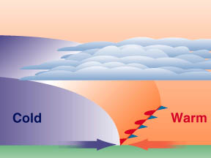
Stationary Front
When a cold air mass and warm air mass meet, but neither air mass has enough force to move the other air mass.

Slide 11
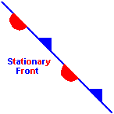
Stationary Front Symbol

Slide 12
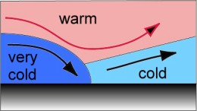
Occluded Front
When a warm air mass is caught between two cooler air masses and the thicker cold air masses move underneath the thinner warm air mass and push it upward.

Slide 13
Occluded front symbol – The directions that the bumps face is the direction the front is moving.

Slide 14
